Slide 1
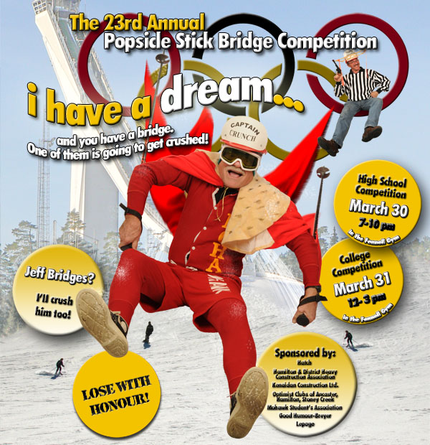
The 23rd Annual
Popsicle Stick Bridge Competition
2010 College Winners Gallery

Slide 2
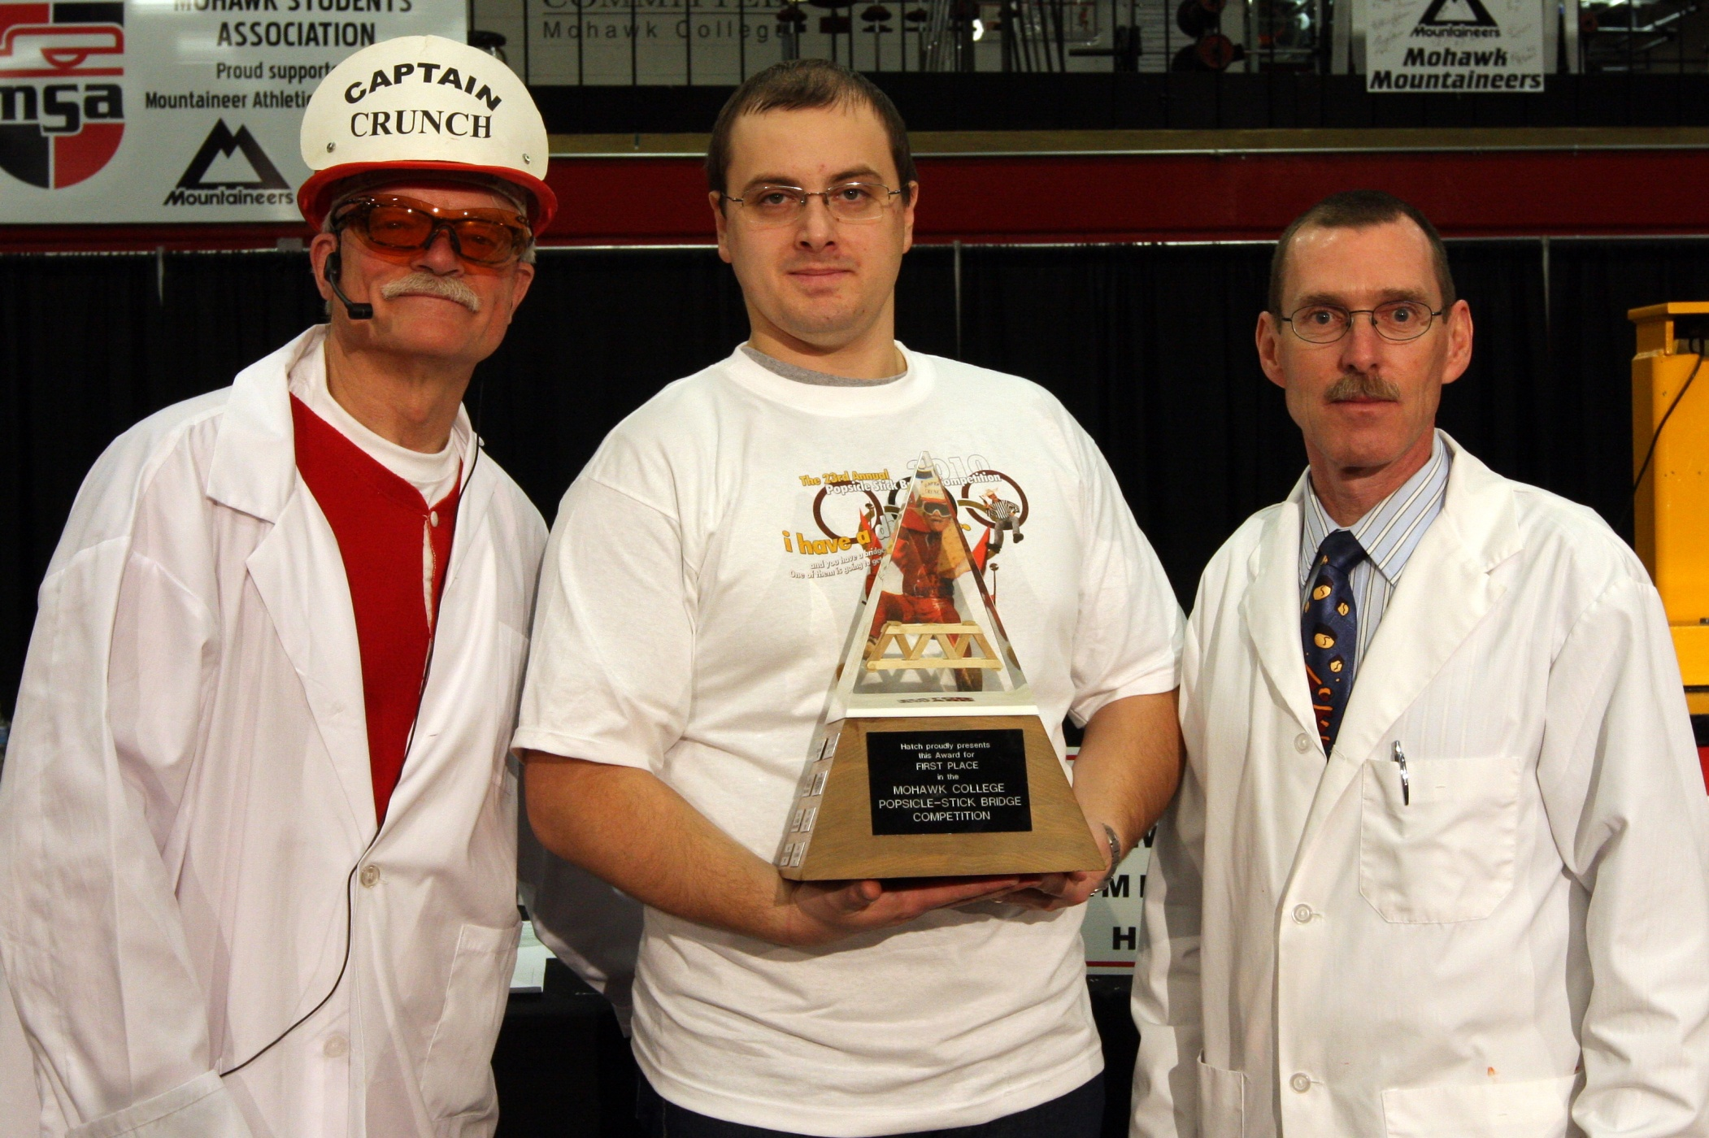
The 23rd Annual
Popsicle Stick Bridge Competition
1st Place Overall Winner Bogdan Ardeleanu

Slide 3
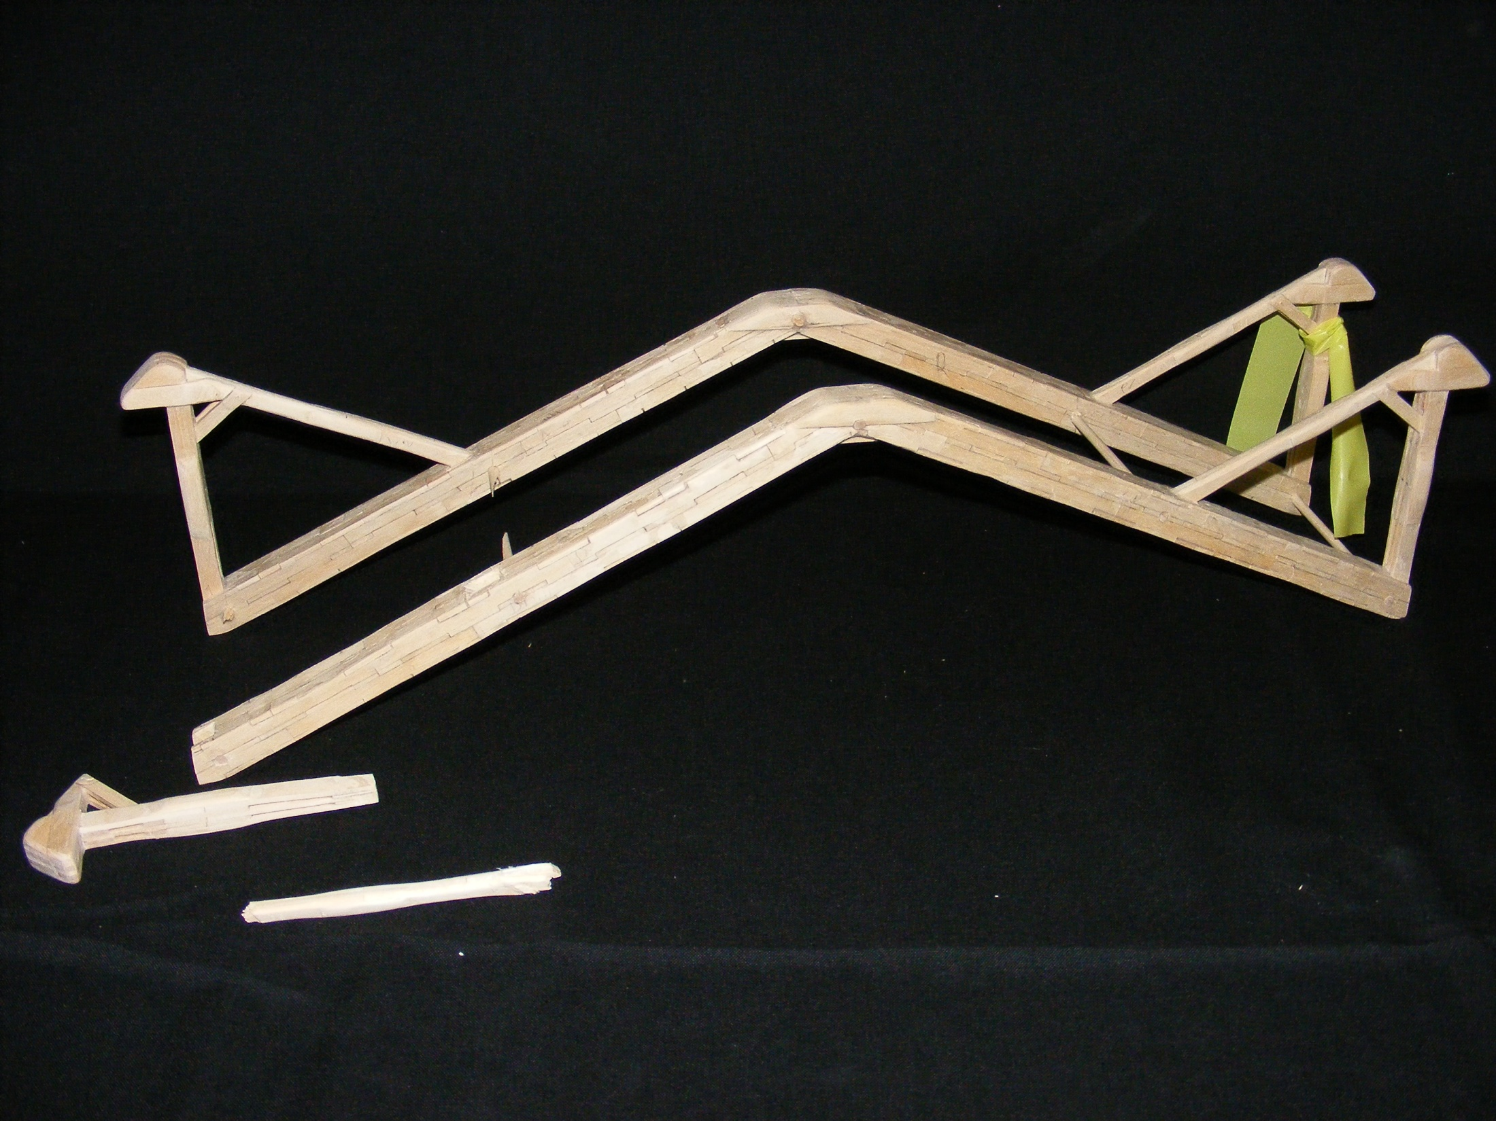
The 23rd Annual
Popsicle Stick Bridge Competition
1st Place Overall
Bridge Weight = 223.4g
Performance Rating = 4473.2 lb/lb

Slide 4
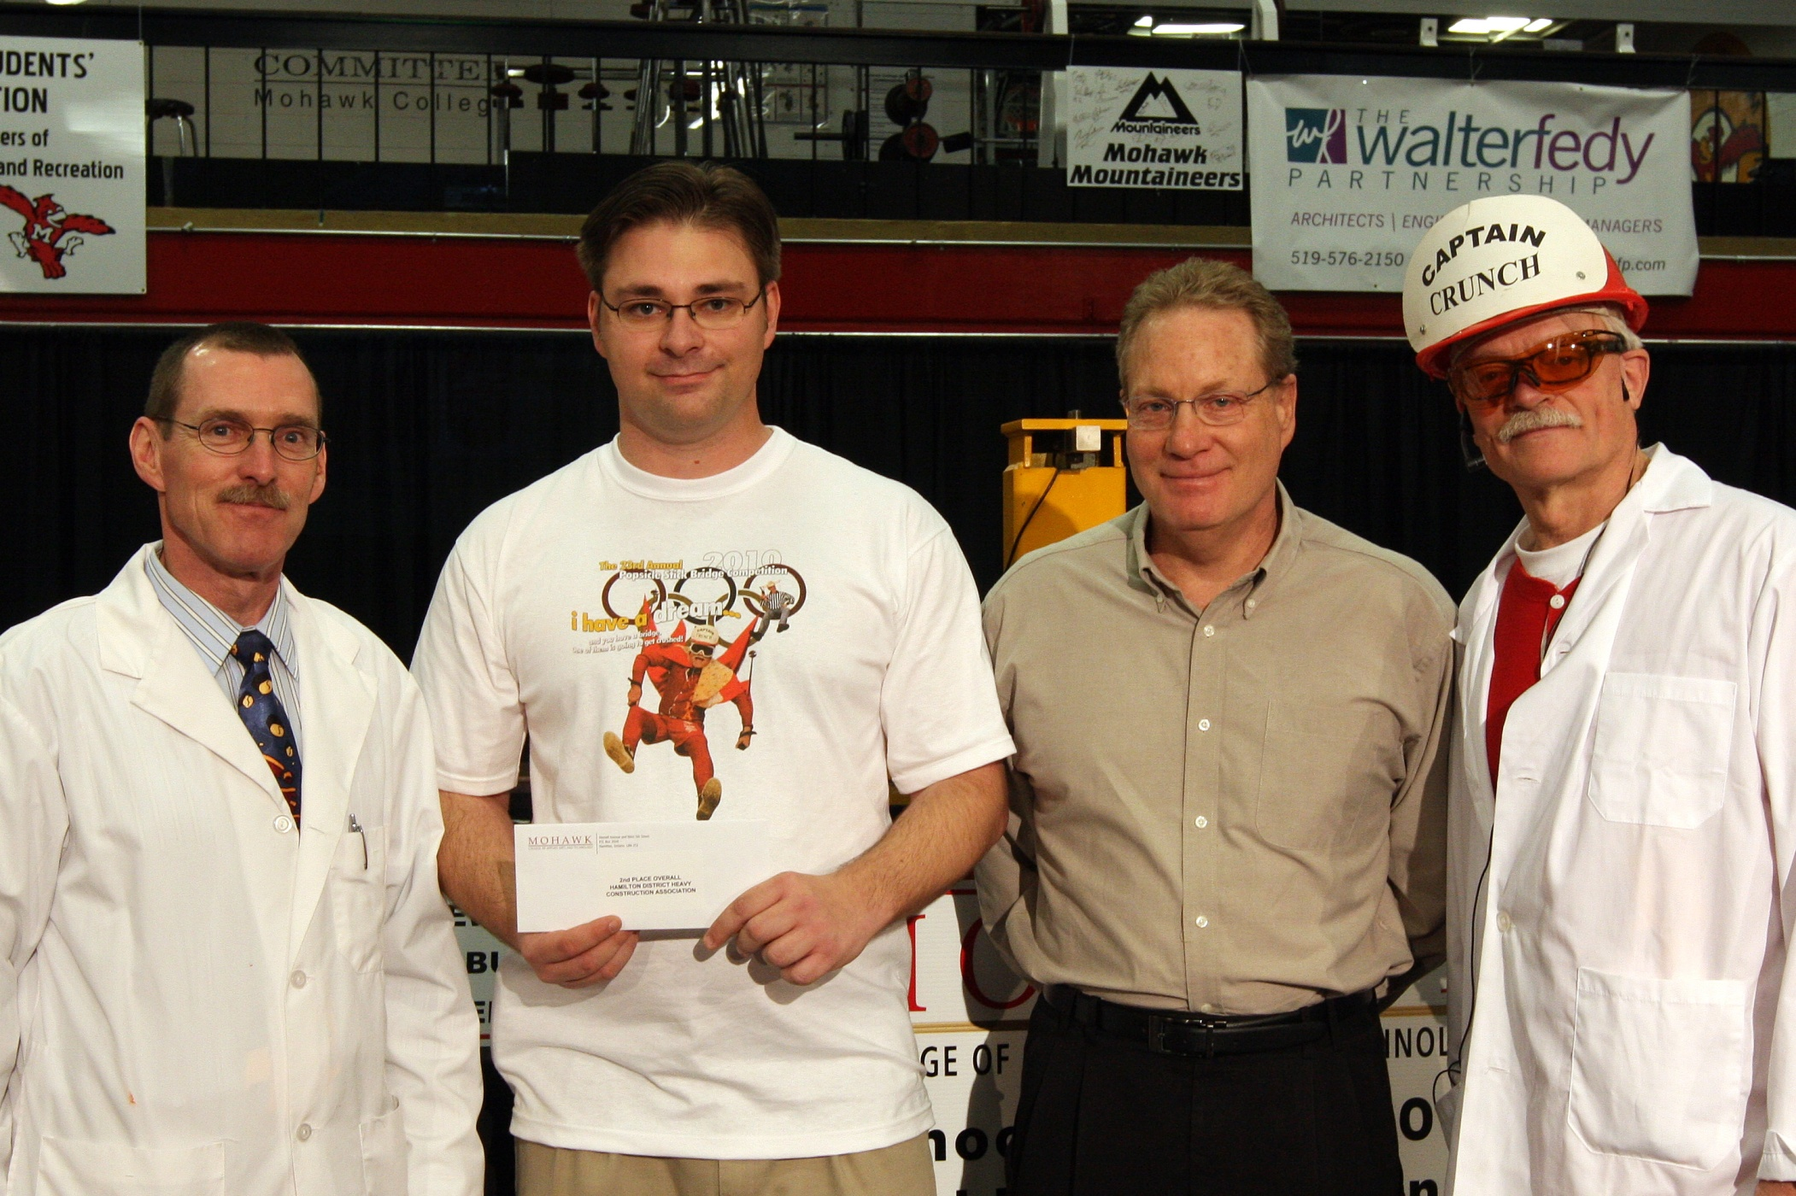
The 23rd Annual
Popsicle Stick Bridge Competition
2nd Place Overall and 2nd Best Workmanship Shane Given

Slide 5
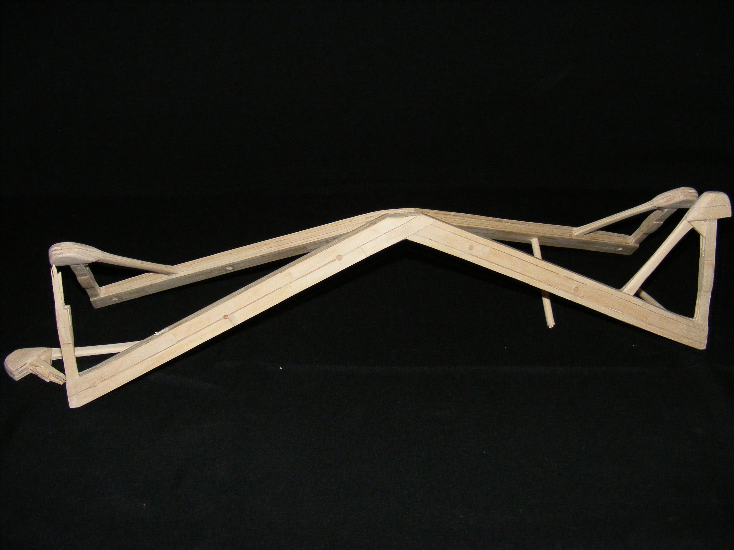
The 23rd Annual
Popsicle Stick Bridge Competition
2nd Place Overall and
2nd Best Workmanship
Bridge Weight = 248.8g
Performance Rating = 4458.8 lb/lb

Slide 6
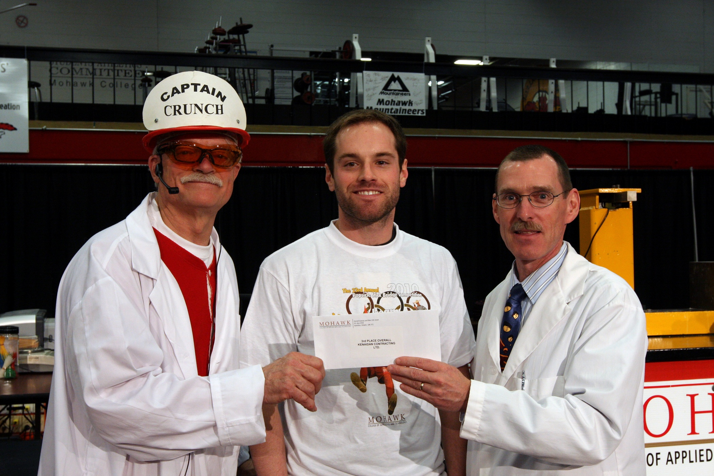
The 23rd Annual
Popsicle Stick Bridge Competition
3rd Place Overall and Best 1st Year Student Ben Gammie

Slide 7
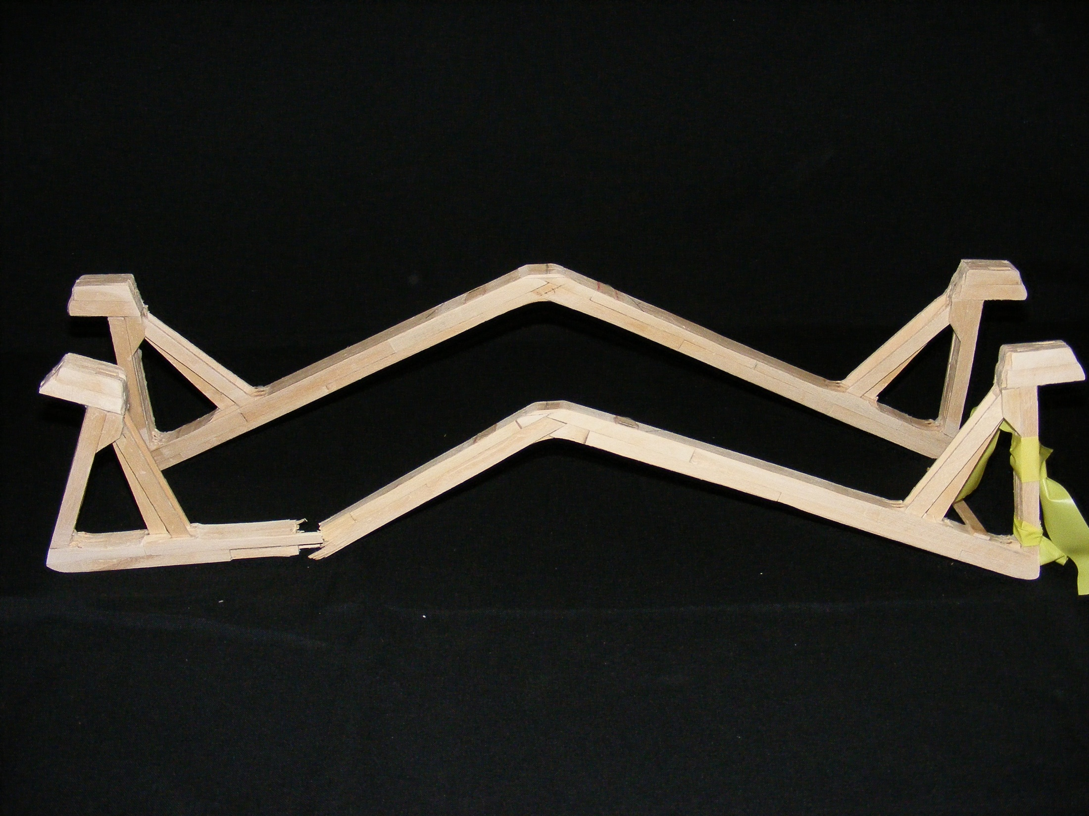
The 23rd Annual
Popsicle Stick Bridge Competition
3rd Place Overall and
Best 1st Year Student
Bridge Weight = 248.3g
Performance Rating = 3968.3 lb/lb

Slide 8
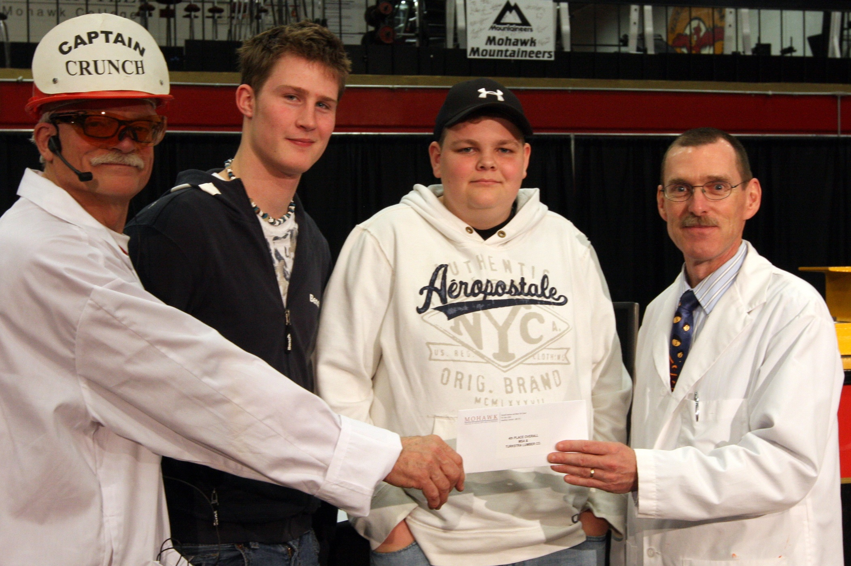
The 23rd Annual
Popsicle Stick Bridge Competition
4th Place Overall Louis Andree and Travis Vanderskooy

Slide 9
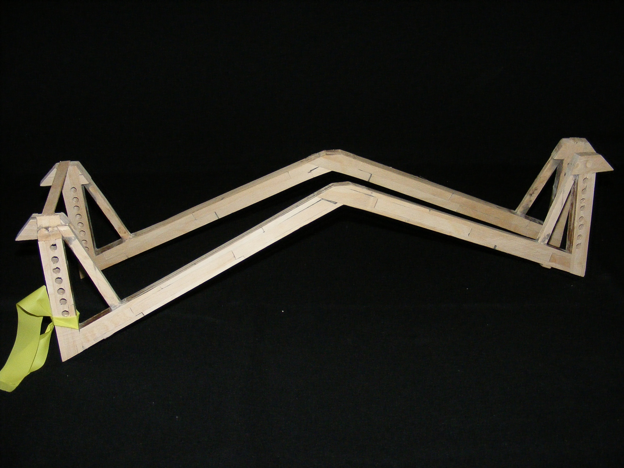
The 23rd Annual
Popsicle Stick Bridge Competition
4th Place Overall
Bridge Weight = 223.1g
Performance Rating = 2960.7 lb/lb

Slide 10
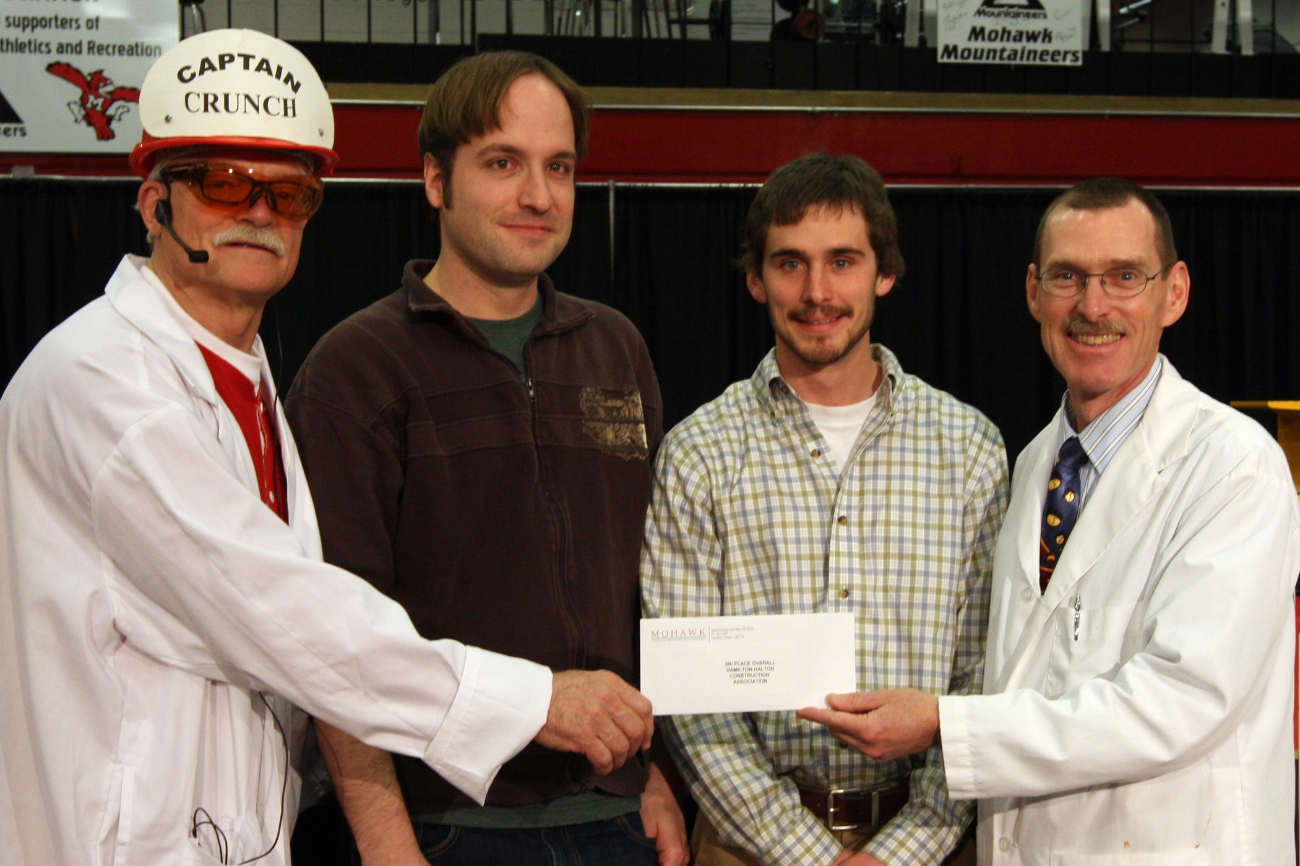
The 23rd Annual
Popsicle Stick Bridge Competition
5th Place Overall Mark Ganassin and Tim Scott

Slide 11
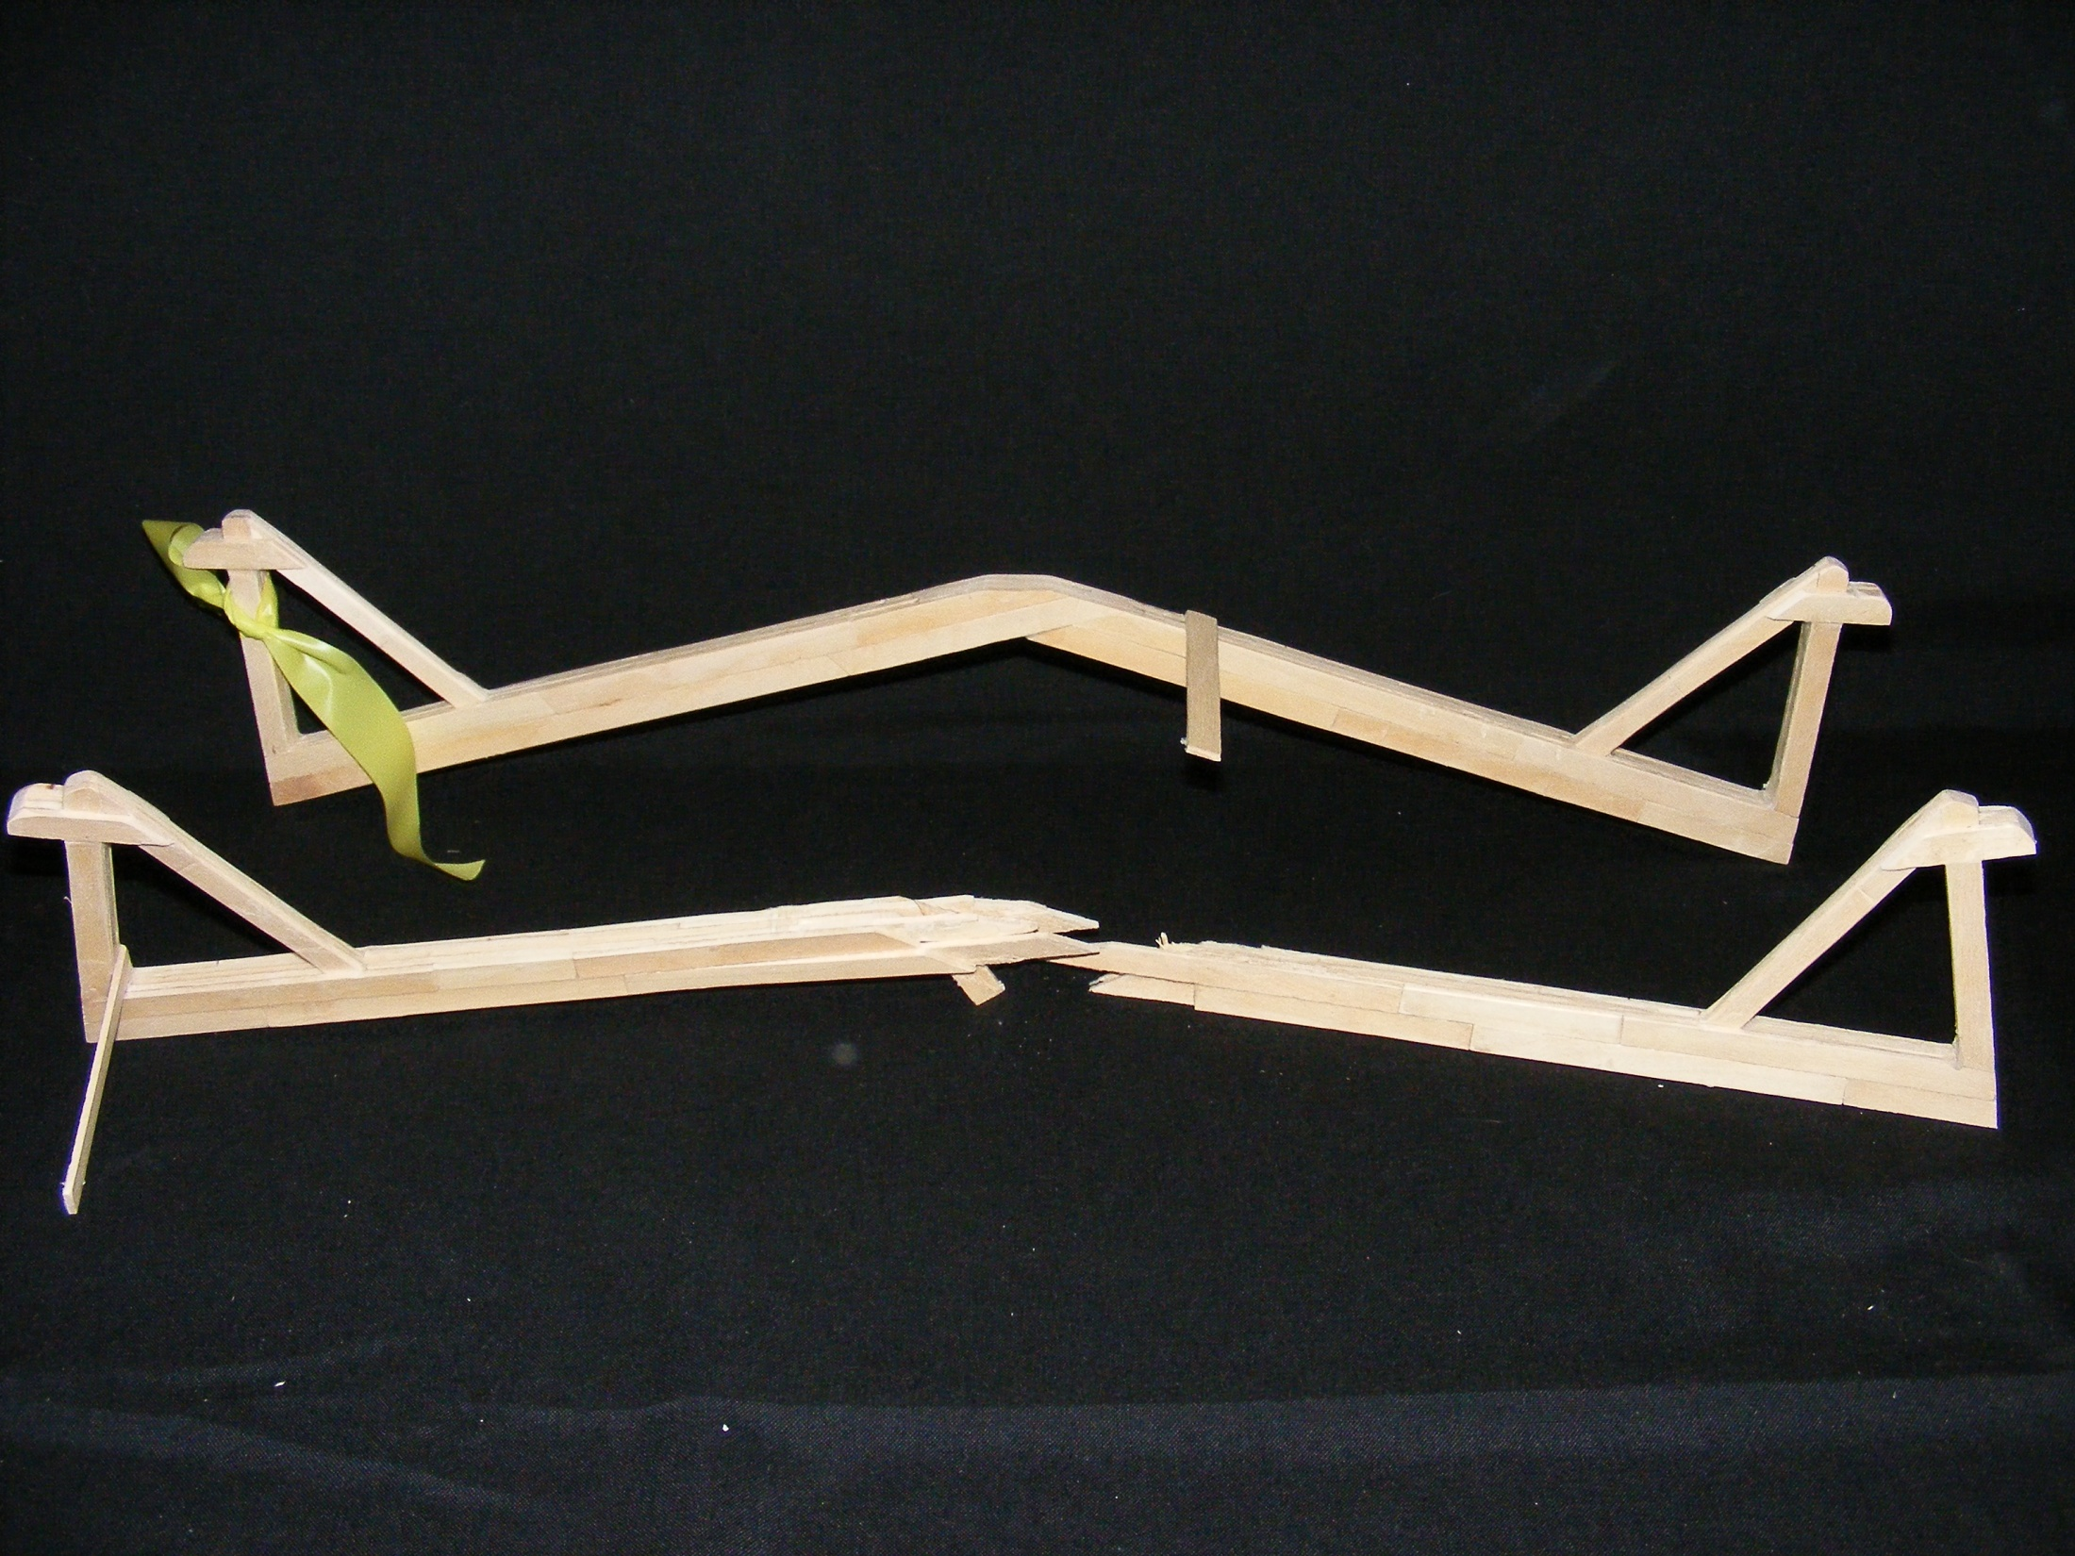
The 23rd Annual
Popsicle Stick Bridge Competition
5th Place Overall
Bridge Weight = 184.0g
Performance Rating = 2855.8 lb/lb

Slide 12
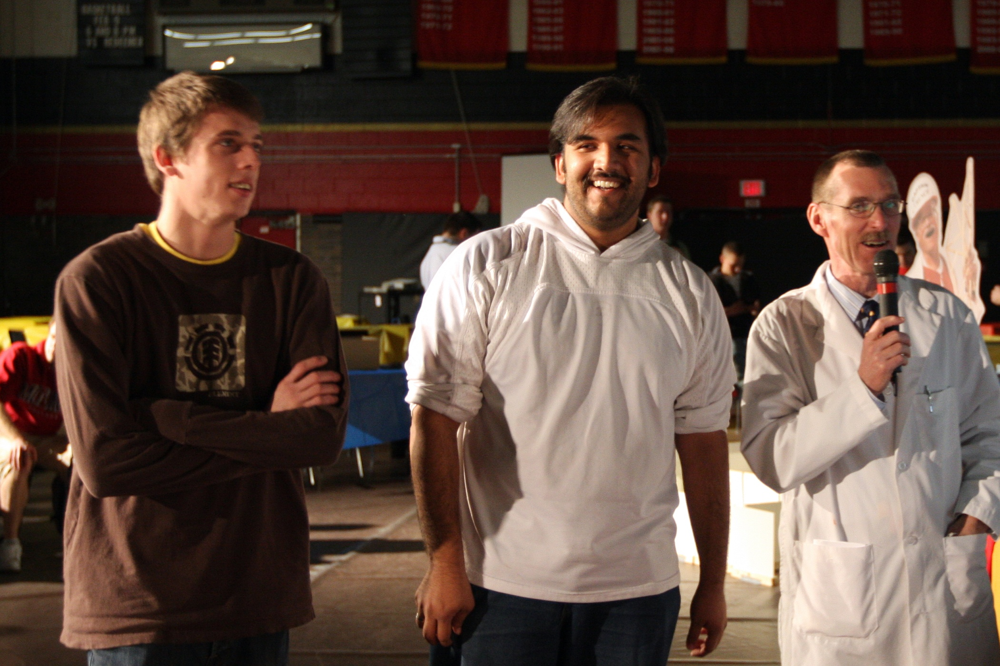
The 23rd Annual
Popsicle Stick Bridge Competition
6th Place Overall Marshall Duhig and Irfan Siddiqui

Slide 13
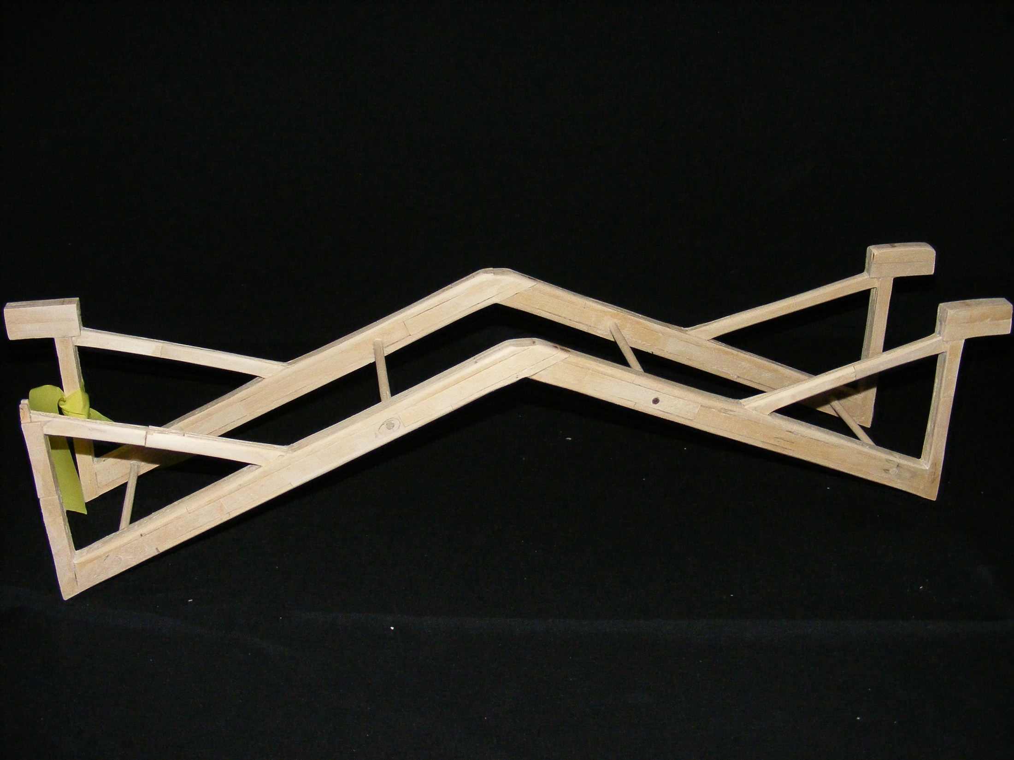
The 23rd Annual
Popsicle Stick Bridge Competition
6th Place Overall
Bridge Weight = 213.9g
Performance Rating = 2829.7 lb/lb

Slide 14
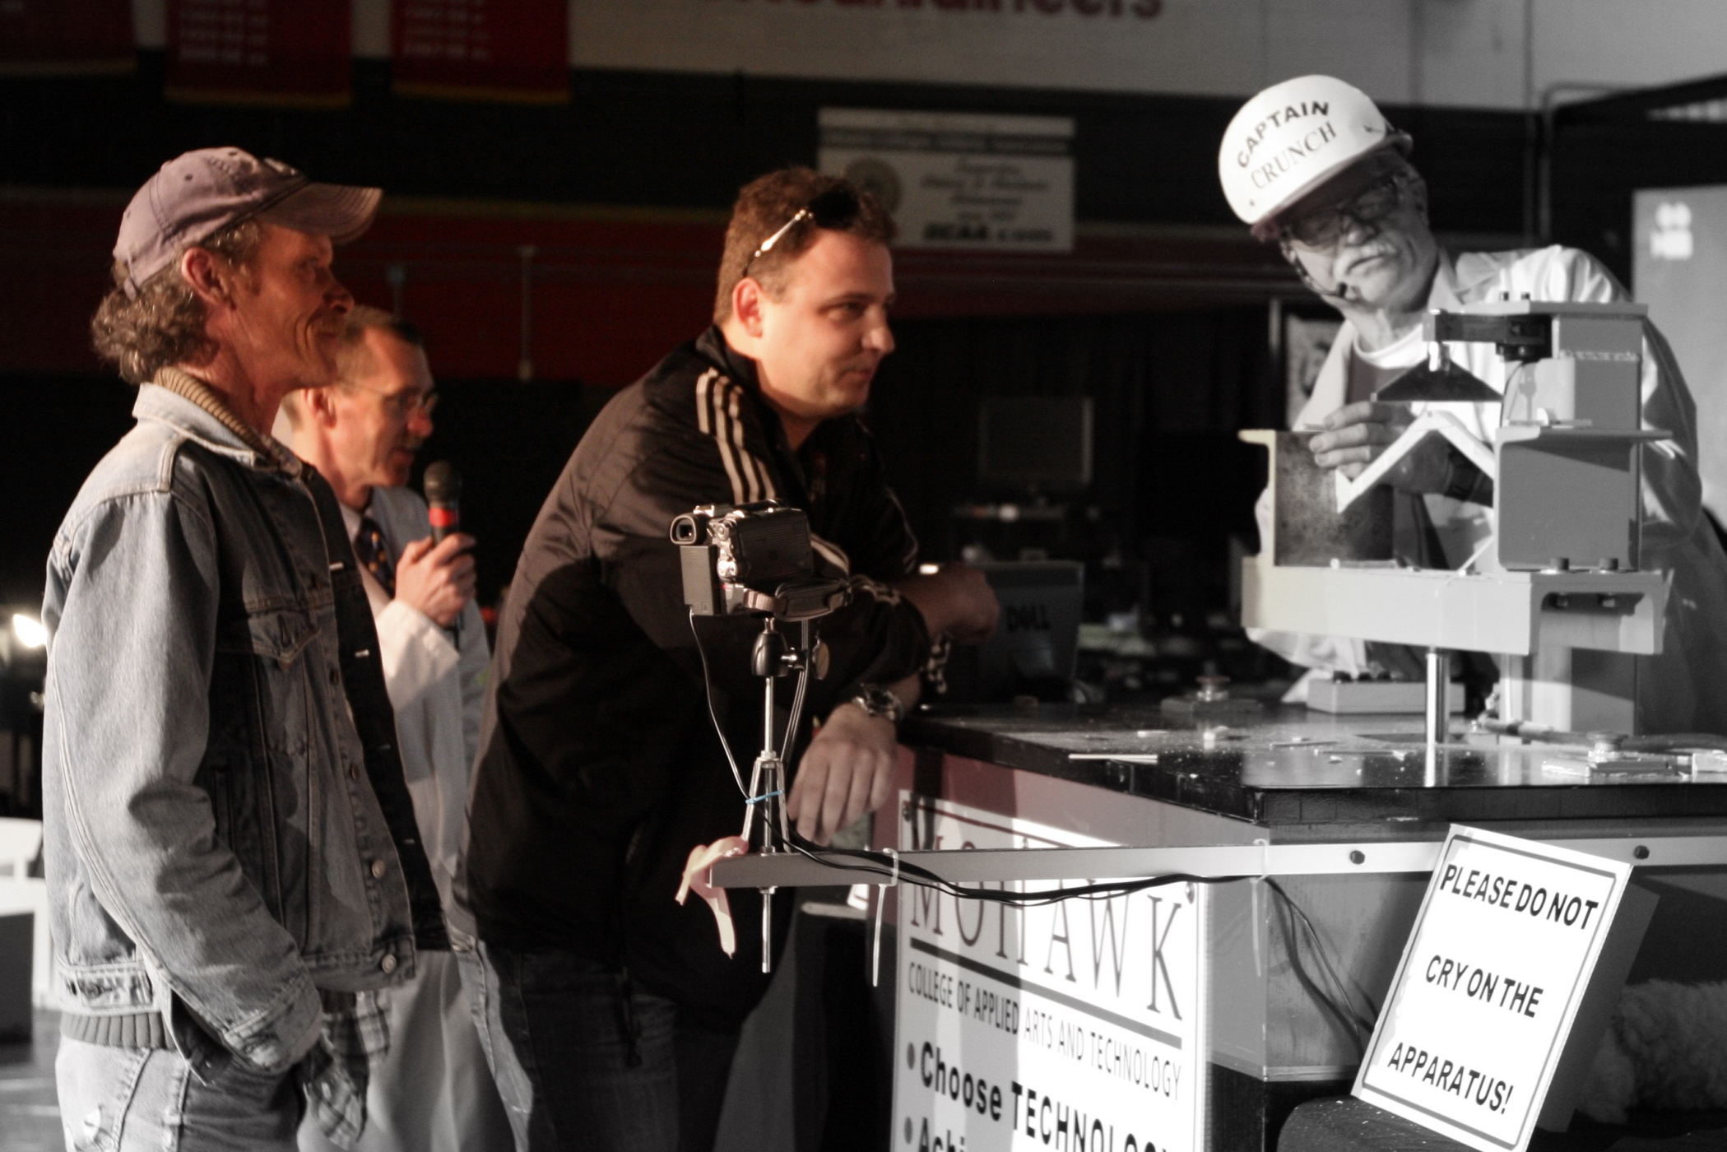
The 23rd Annual
Popsicle Stick Bridge Competition
Best Performing Lightweight Structure Craig Patterson and Jacob Grzech

Slide 15
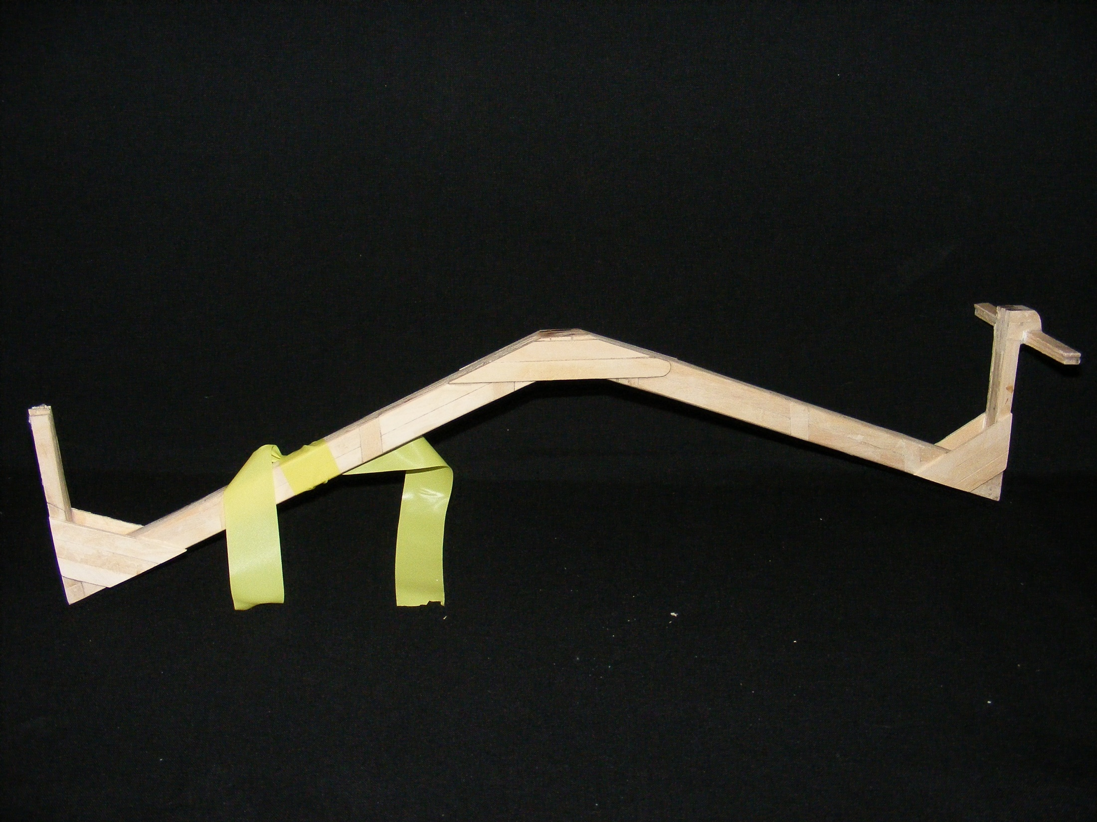
The 23rd Annual
Popsicle Stick Bridge Competition
Best Performing
Lightweight Structure
Bridge Weight = 112.4g
Performance Rating = 1928.1 lb/lb

Slide 16
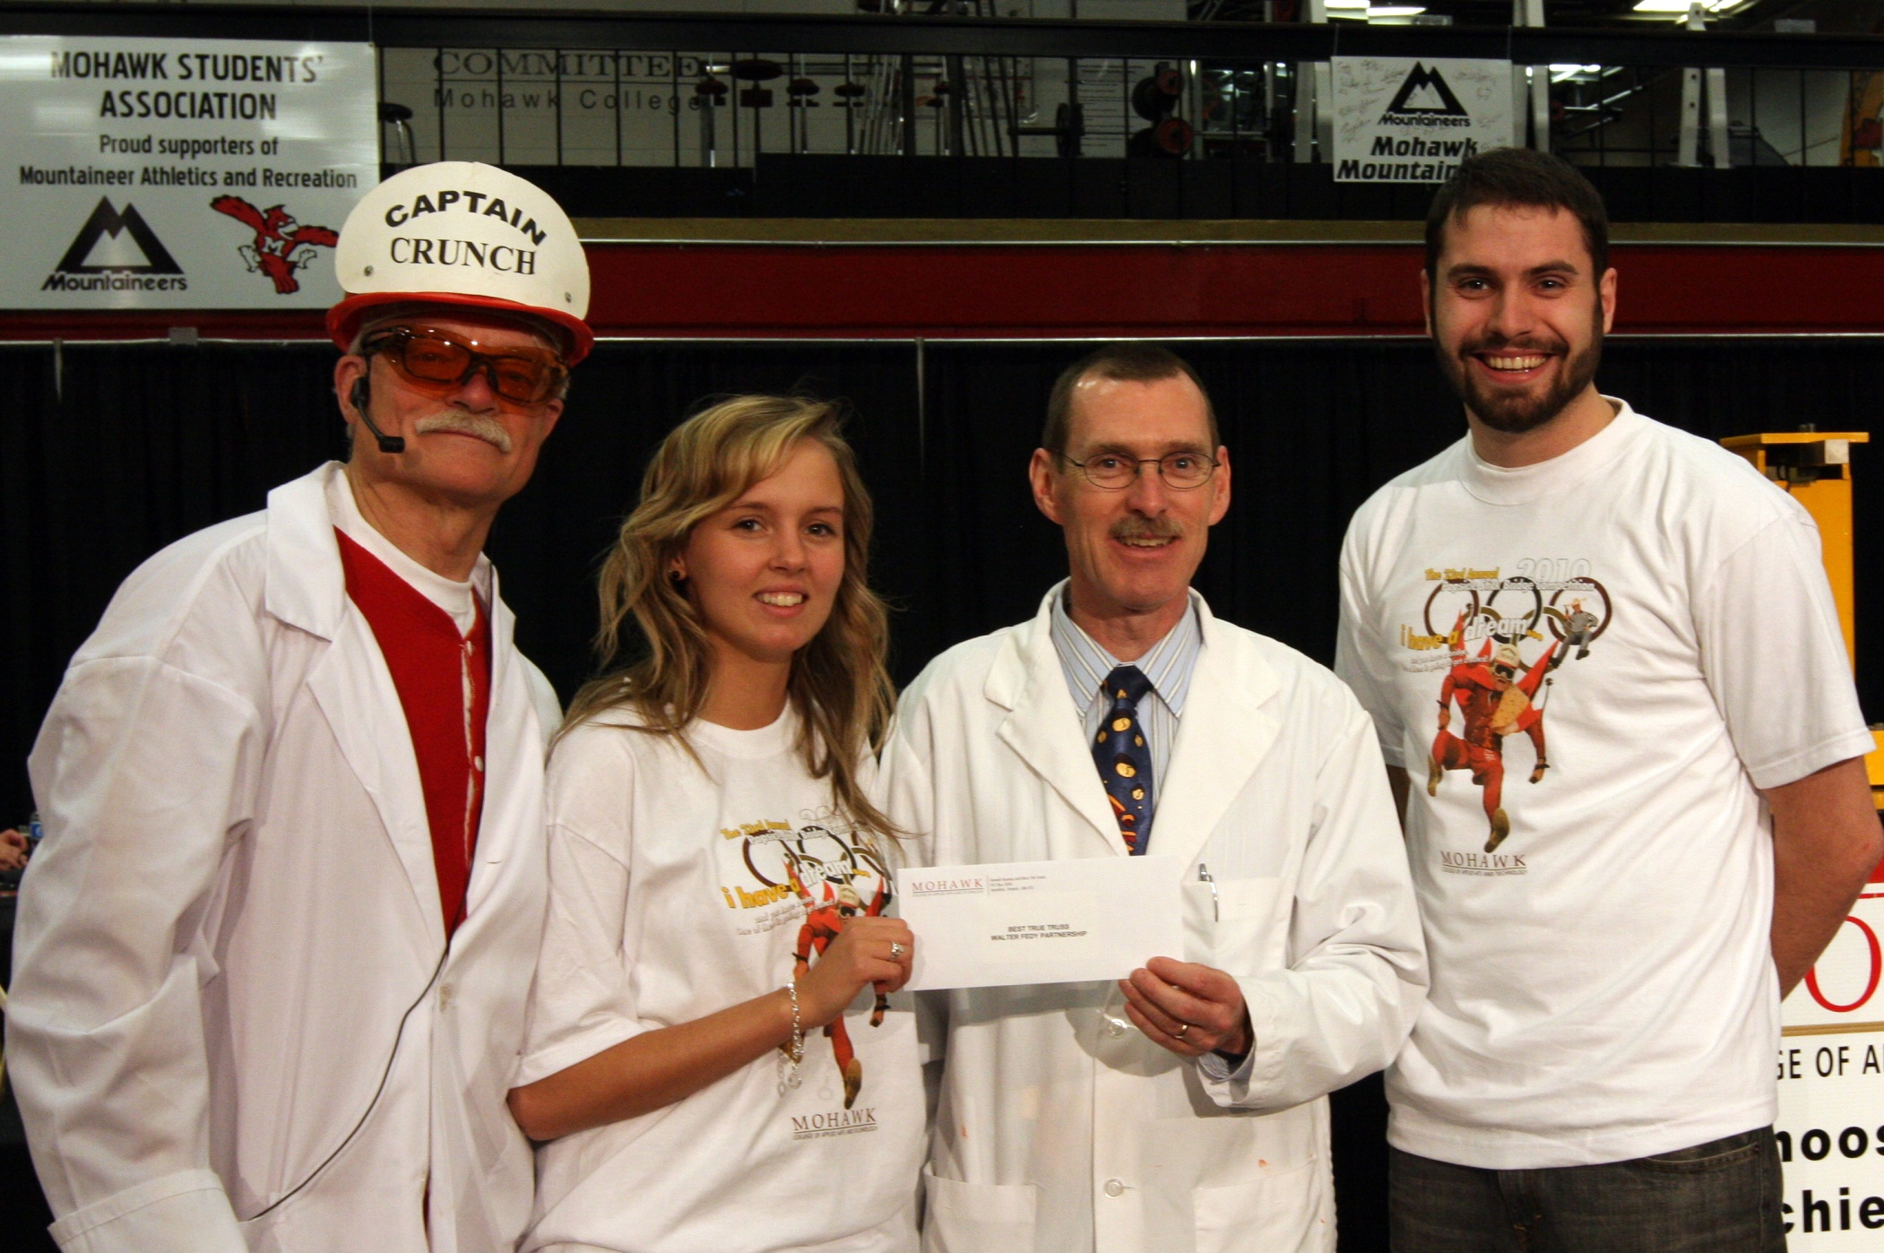
The 23rd Annual
Popsicle Stick Bridge Competition
Best True Truss and Best Workmanship Leanne Borges and Chris Turner

Slide 17
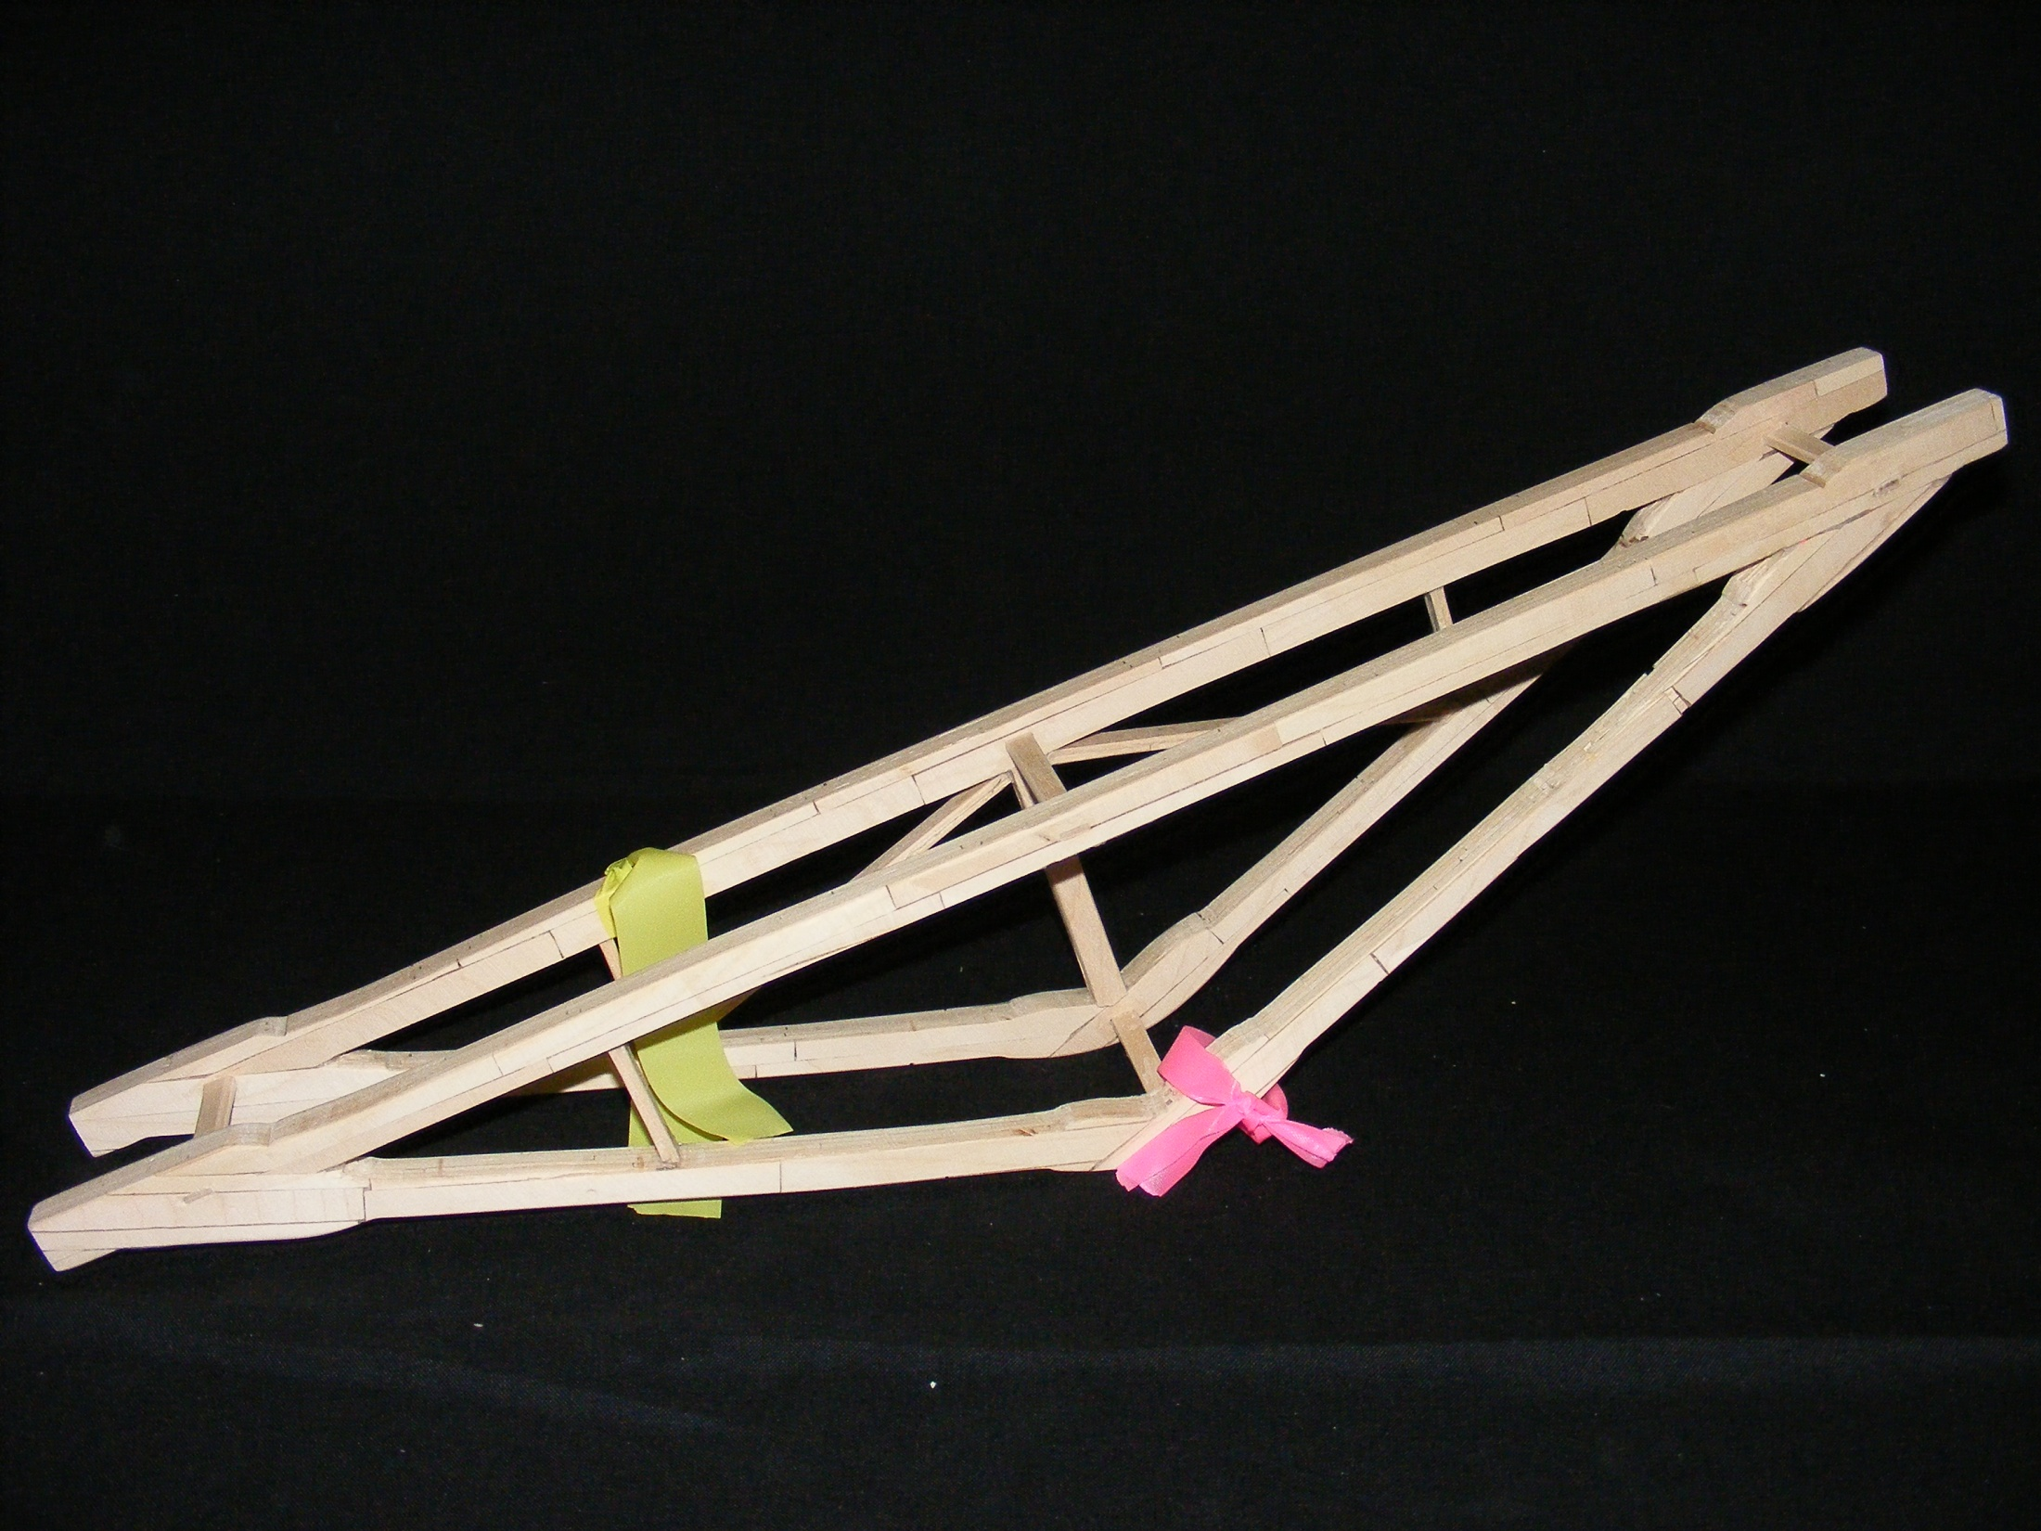
The 23rd Annual
Popsicle Stick Bridge Competition
Best True Truss and
Best Workmanship
Bridge Weight = 248.4g
Performance Rating = 2034.1 lb/lb

Slide 18
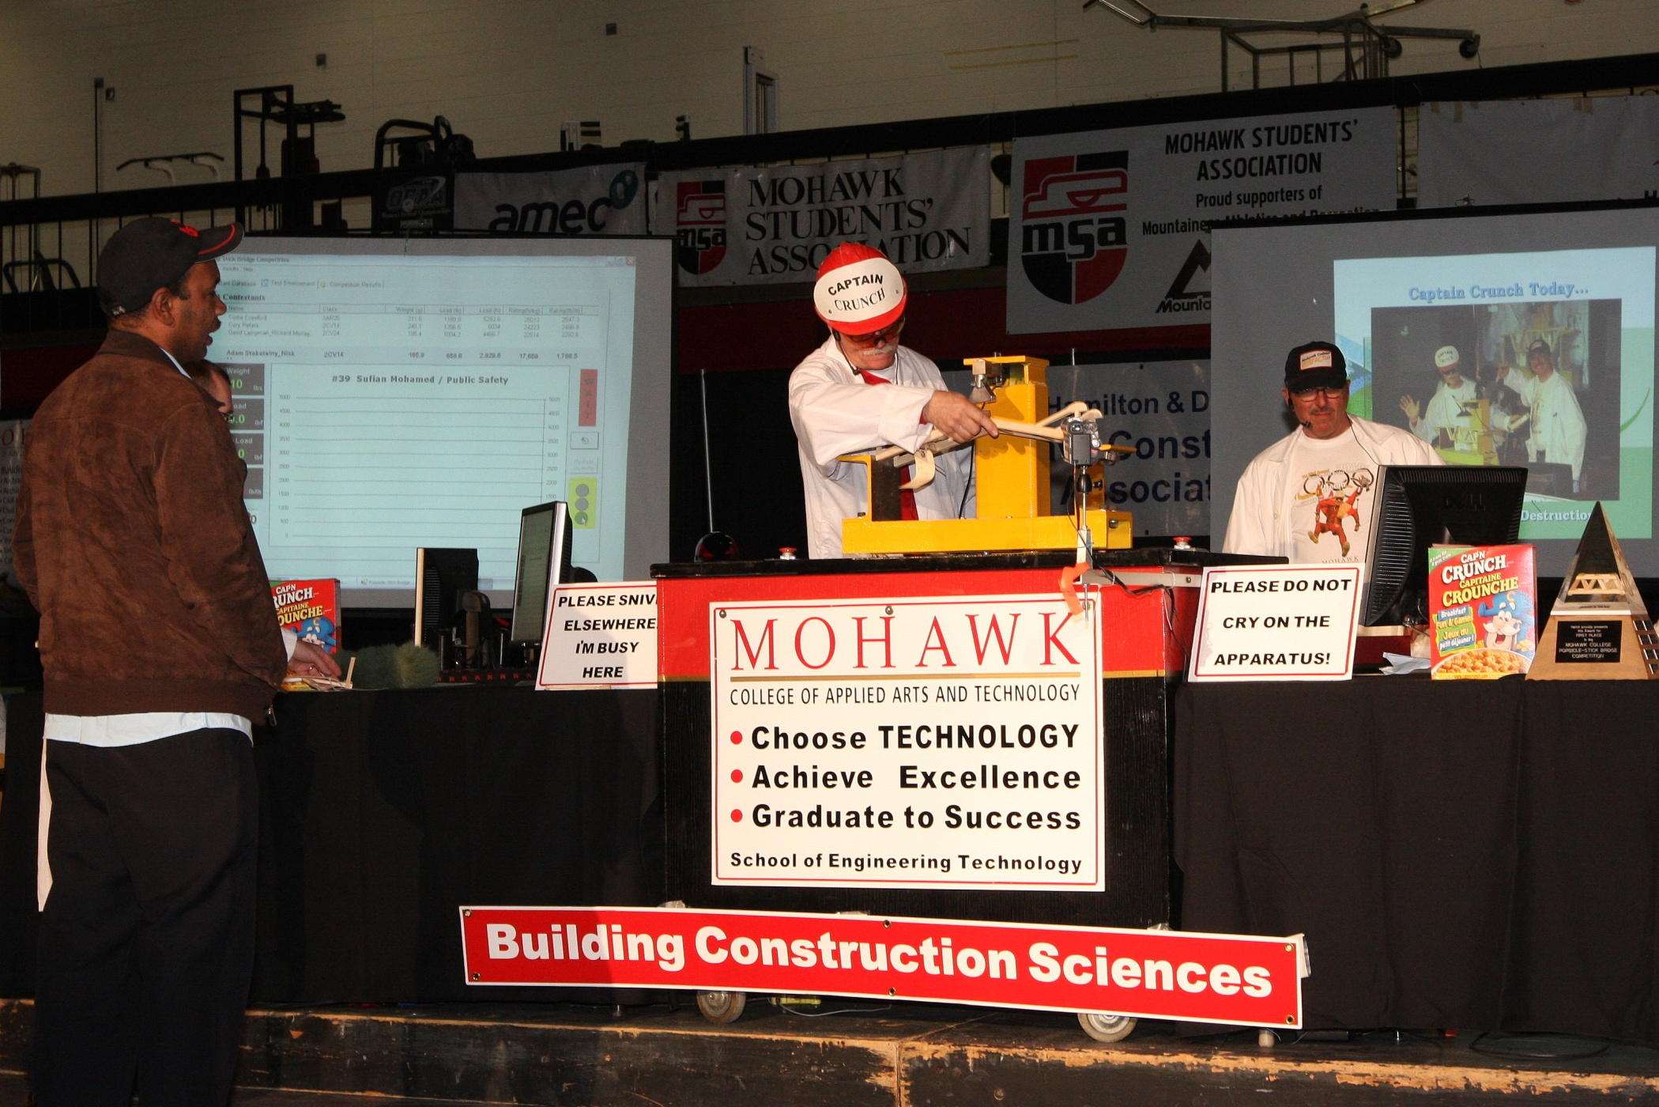
The 23rd Annual
Popsicle Stick Bridge Competition
Best Non Building and Construction Sciences Student
Sufian Mohamed

Slide 19
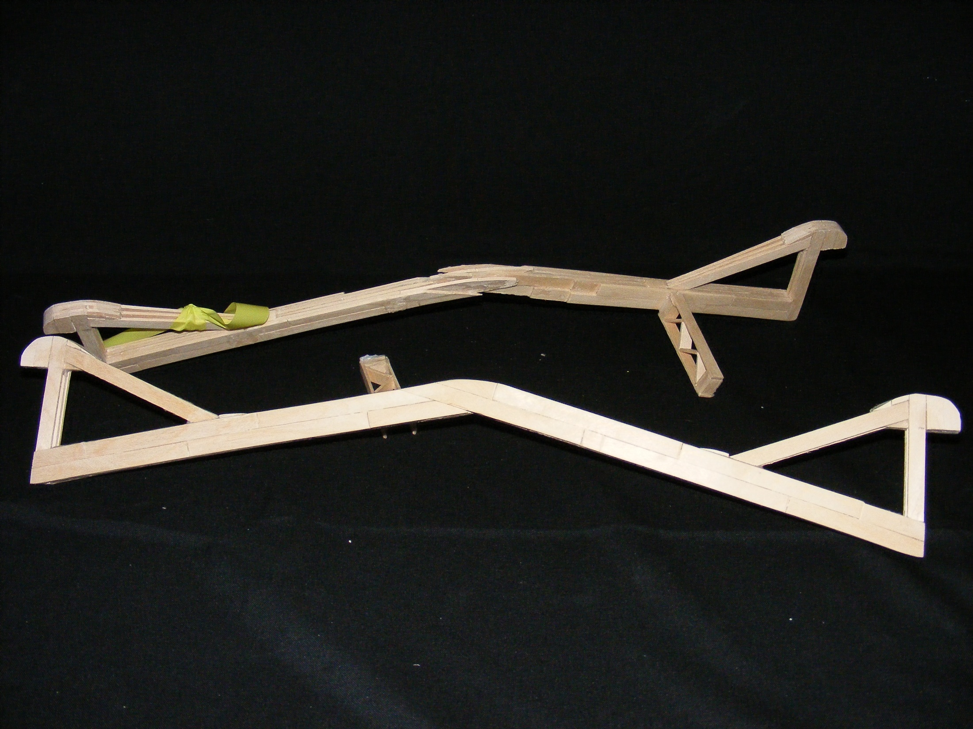
The 23rd Annual
Popsicle Stick Bridge Competition
Best Non Building and Construction Sciences Student
Bridge Weight = 231.5g
Performance Rating = 1933.3 lb/lb

Slide 20
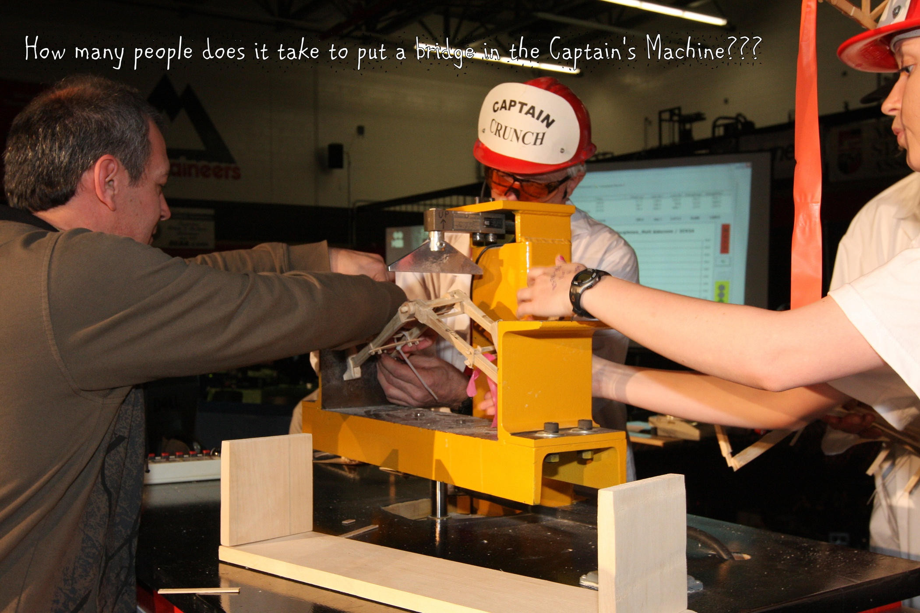
The 23rd Annual
Popsicle Stick Bridge Competition
Most Unique Design Tibby Margineau and Matt Alderson

Slide 21
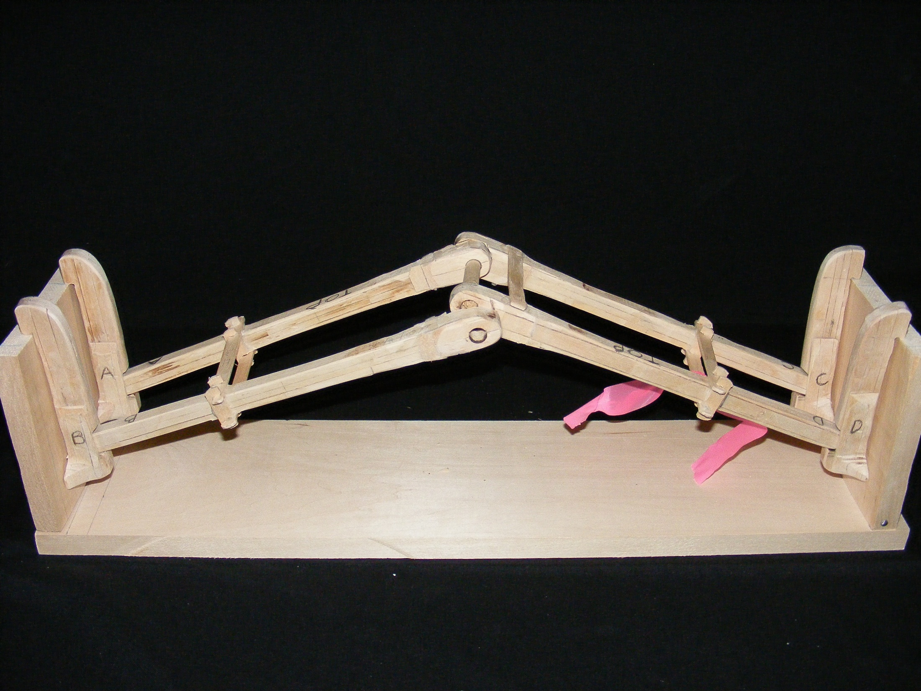
The 23rd Annual
Popsicle Stick Bridge Competition
Most Unique Design
Bridge Weight = 246.7g
Performance Rating = 1455.7 lb/lb

Slide 22
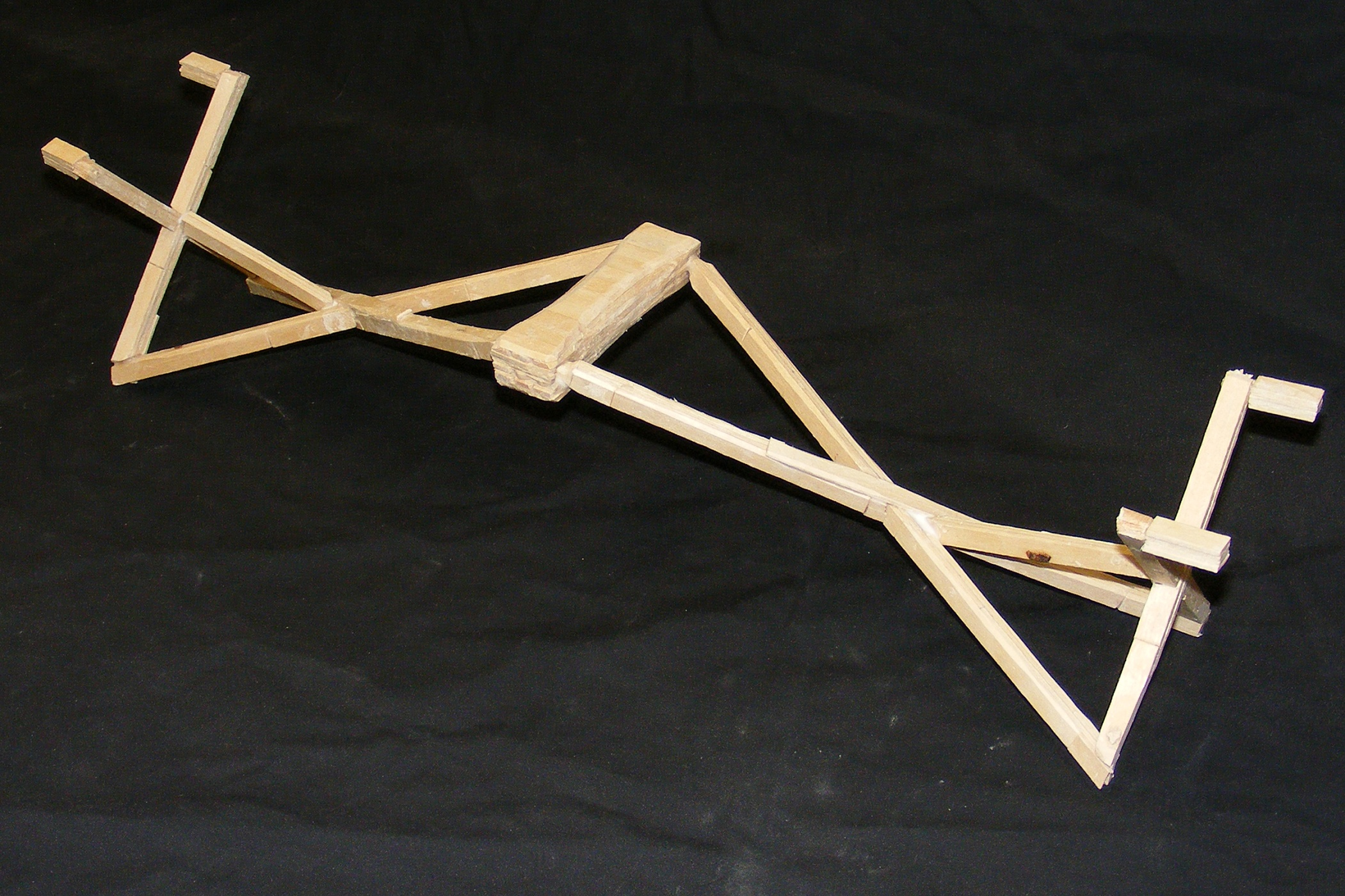
The 23rd Annual
Popsicle Stick Bridge Competition
Second Most Unique Design Nicolas Cardenosa

Slide 23
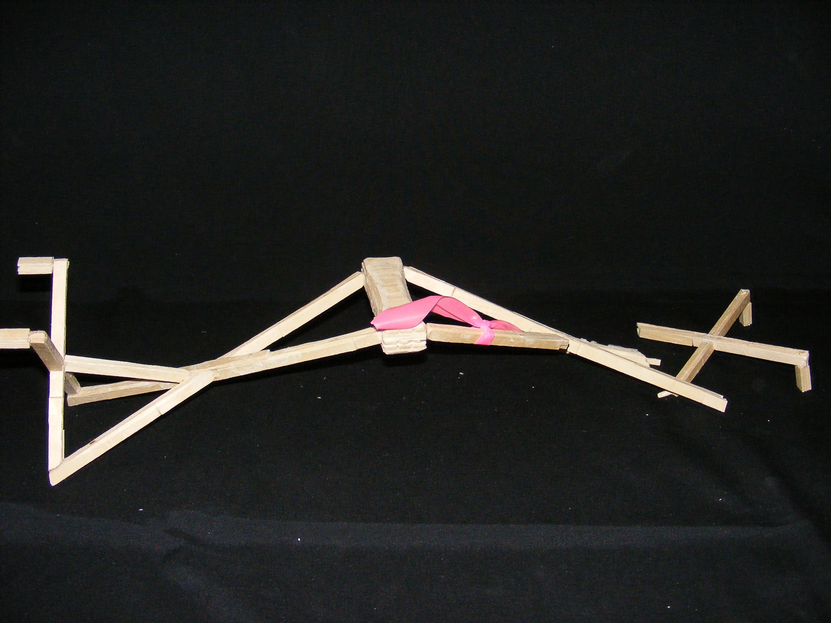
The 23rd Annual
Popsicle Stick Bridge Competition
Second Most Unique Design
Bridge Weight = 144.3g
Performance Rating = 106.4 lb/lb

Slide 24
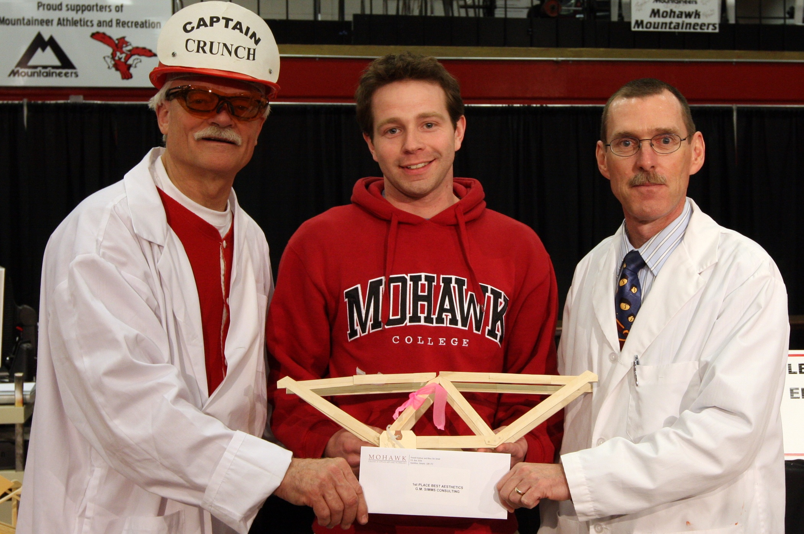
The 23rd Annual
Popsicle Stick Bridge Competition
Best Aesthetics Matt Coultes

Slide 25
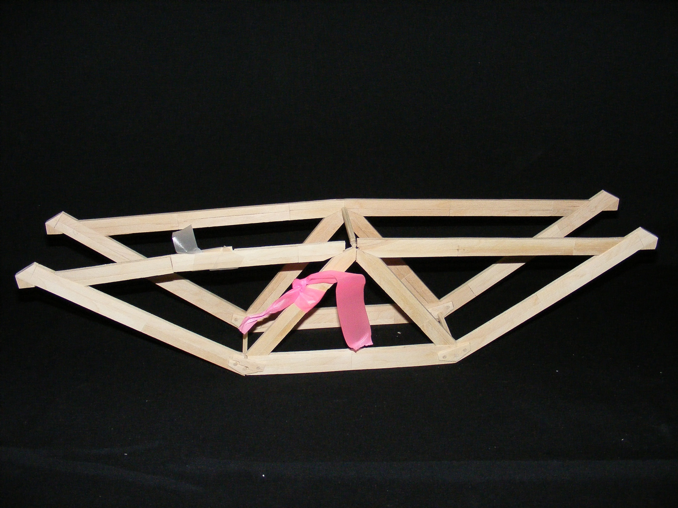
The 23rd Annual
Popsicle Stick Bridge Competition
Best Aesthetics
Bridge Weight = 139.0g
Performance Rating = 839.2 lb/lb

Slide 26
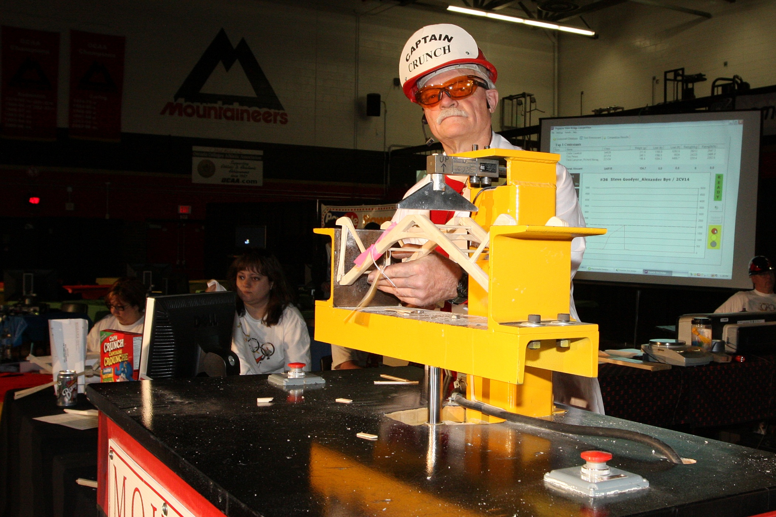
The 23rd Annual
Popsicle Stick Bridge Competition
Second Best Aesthetics Steve Goodyer and Alexander Bye

Slide 27
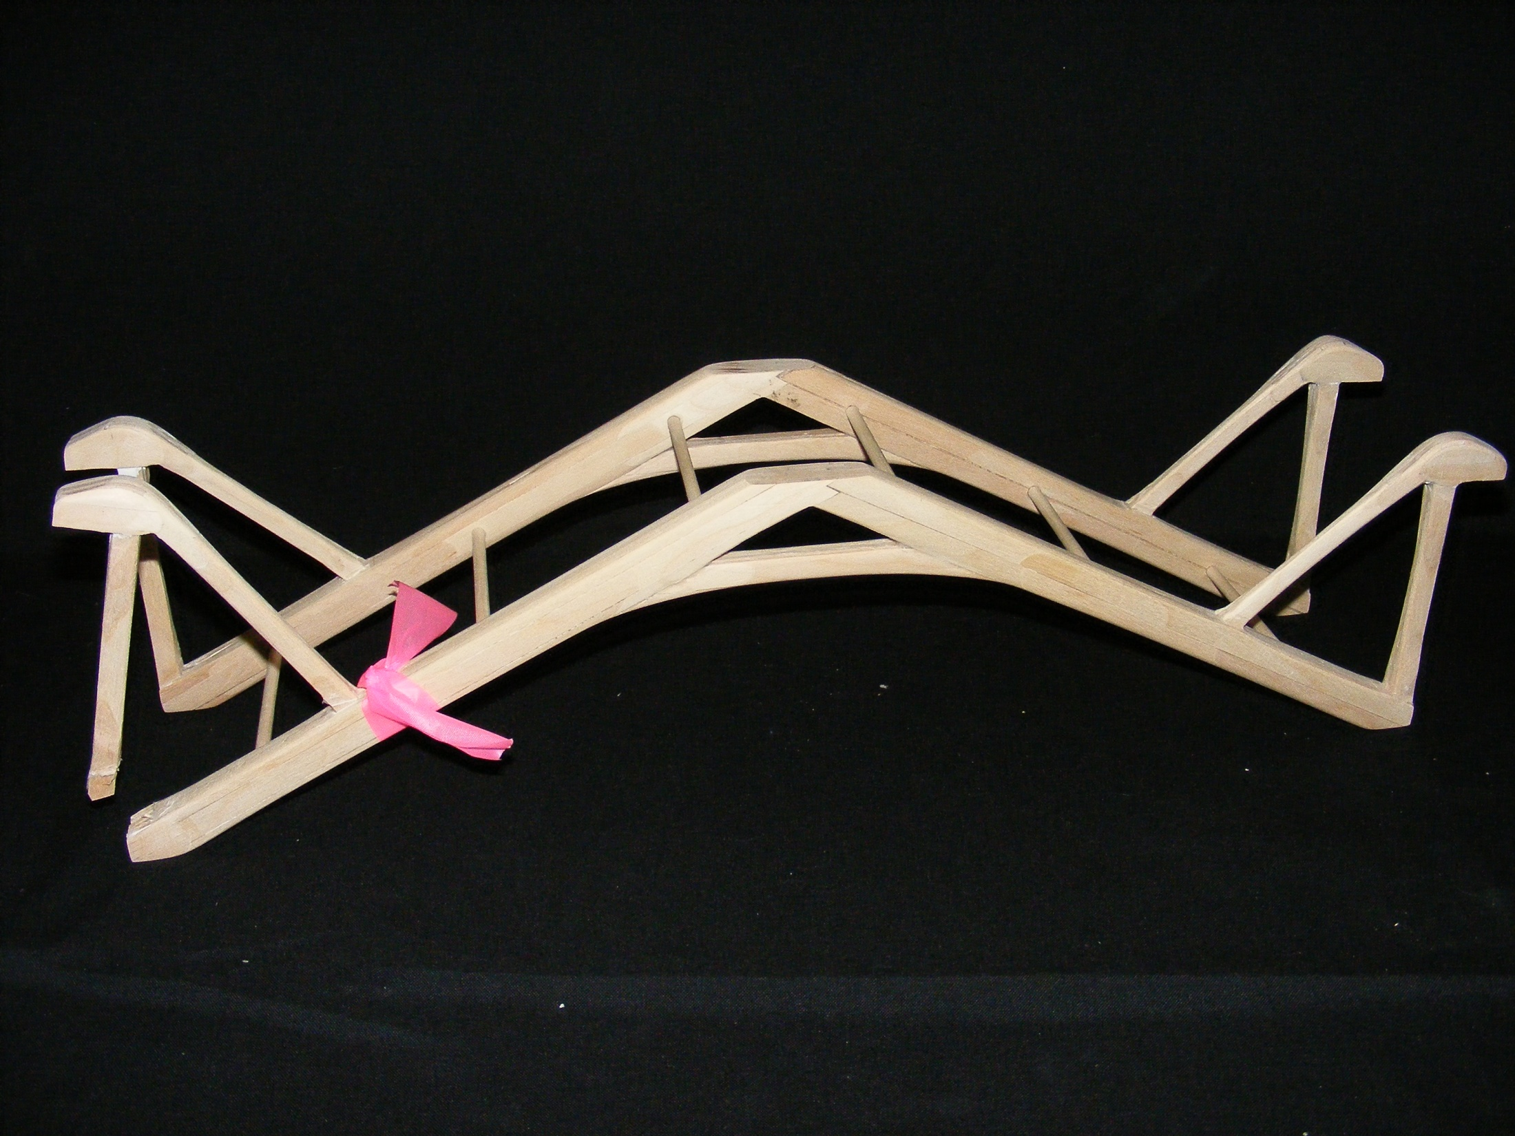
The 23rd Annual
Popsicle Stick Bridge Competition
Second Best Aesthetics
Bridge Weight = 244.6g
Performance Rating = 1992.6 lb/lb

Slide 28











The 23rd Annual
Popsicle Stick Bridge Competition
G.M. Simms
A Special Thanks to all of our Sponsors

